Slide 1
Fill in the missing words
Money, money, money
I work all night, I work all day, to pay the 1) …… I have to 2) …… Ain't it sad And still there never seems to be a single 3) ….. left for me That's too bad In my dreams I have a plan If I got me a 4) ……….. man I wouldn't have to work at all, I'd fool around and have a ball...
Money, money, money Must be funny In the rich man's world Money, money, money Always sunny In the 4) …….. man's world Aha-ahaaa All the things I could do If I had a little 5) ……. It's a rich man's world It's a rich man's world .

Slide 2
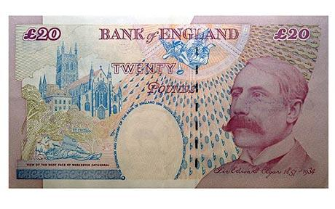
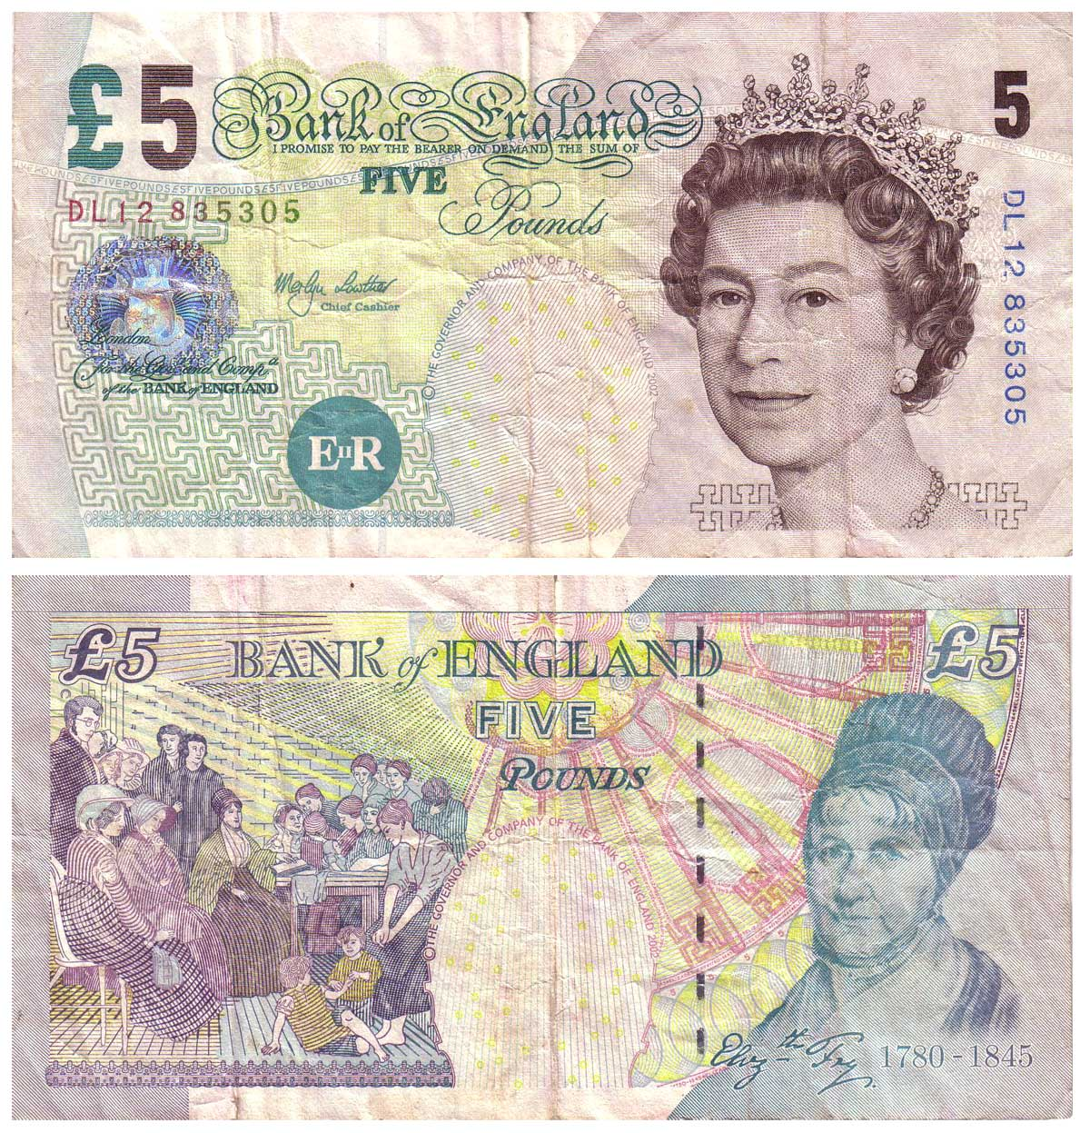
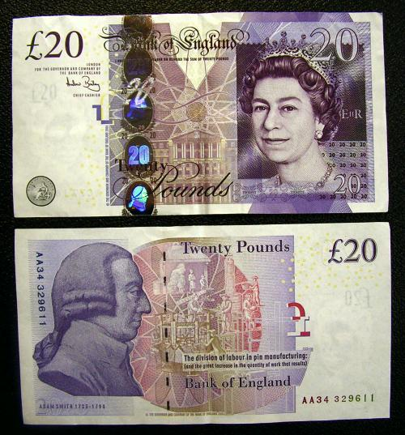
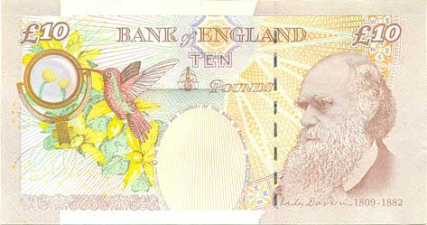

Slide 3
- Who is there on the banknotes? - Why are the faces of famous persons put on the banknotes?

Slide 4
Plan
Name
Colour
Who is on the banknote?
Why?

Slide 5
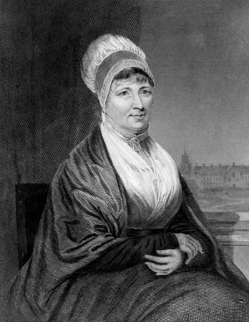
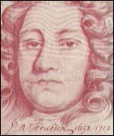
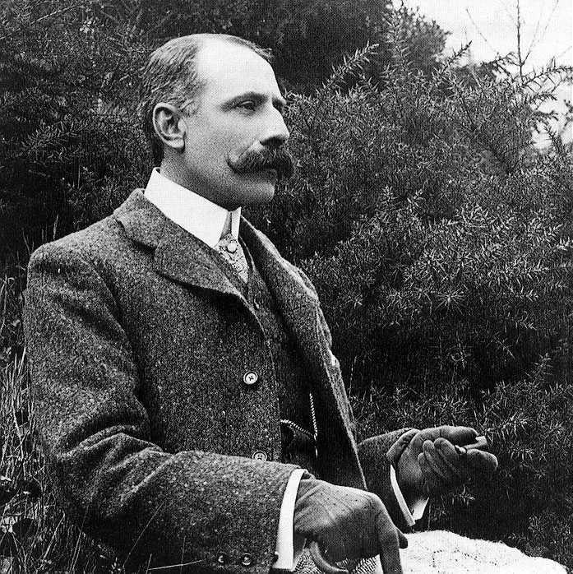
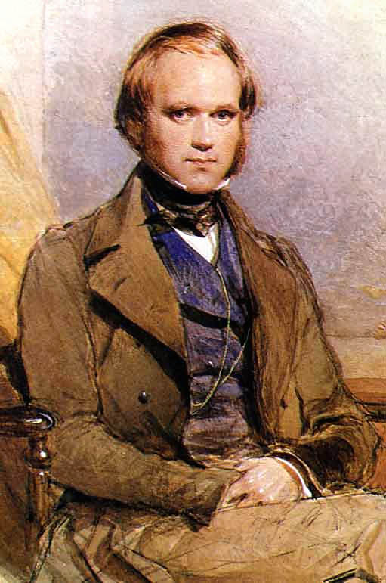
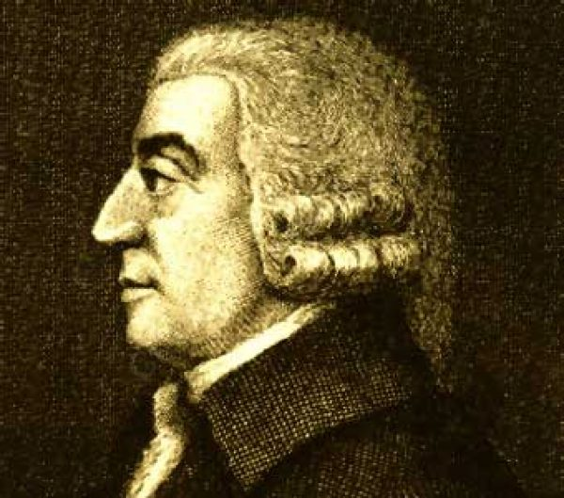
Sir John Houblon
Elizabeth Fry
Edward Elgar
Charles Darwin
Adam Smith

Slide 6
Listen to your partners and fill in the table.
names | colour | Who | why

Slide 7
H/W Speak about Russian banknotes. Present illustration.

Slide 8
Thank you for attention!

